Slide 1

Hash Tables

Slide 2
Hash Table Intro

Slide 3
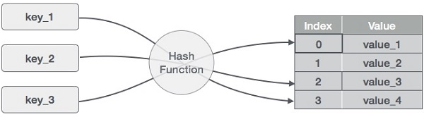
What is a Hash Table?
A hash table is a data structure that stores items by mapping each item to a location in an array.

Slide 4
How does the mapping happen?
STEP ONE: Take an item (integer, string, object, etc.) and pick a unique identifier for this item. This identifier is called the item’s key.
Example: Given a 50-element array with indexes 0 through 49. Our item is an integer with value 1877. Since this item is just a single integer, the key would just be 1877.

Slide 5
How does the mapping happen?
STEP TWO: Use a hash function to map this key to an index in an array.
ARRAY INDEX | ARRAY VALUE
1
2
3
…
26
27 | 1877
…
49
Example: One example hash function is key % SIZE_ARRAY. So 1877 % 50 = 27. So, the value 1877 would be placed in the array with index 27

Slide 6
How does the mapping happen?
Each array element is called a bucket.
A hash function computes a bucket index from the item’s key.

Slide 7
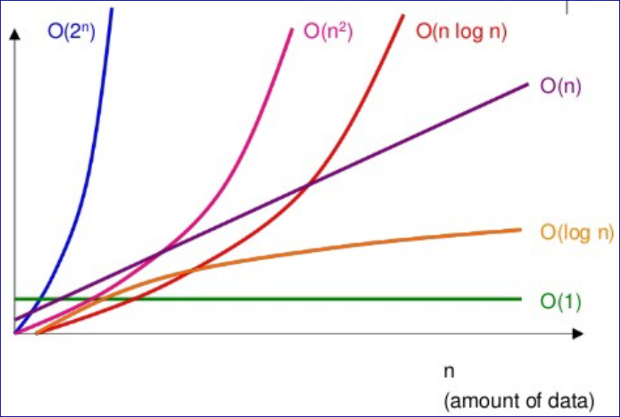
Efficiency of Hash Tables
For a well-designed hash table with a good hash function and unique keys, searching requires O(1) on average.
(This is a hash table’s main advantage!)
Compare Efficiency for Data Structures
Hash Table O(1)
Binary Search Tree (balanced) O(log N)
Binary Search Tree (not balanced) O(N)
Linked List O(N)
Binary Search on Linked List O(log N)

Slide 8
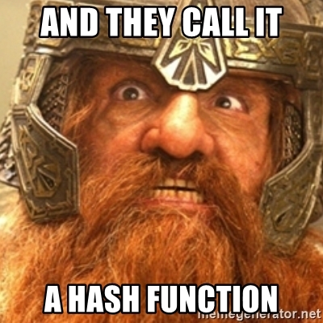
Most Common Hash Function

Slide 9
Hash Function with Modulus Operator (%)
The most common (and 2nd easiest) is the hash function using the modulus operator, which was shown in a previous slide.
KEY % N
Where N is the number of elements or buckets in the hash table.

Slide 10
Hash Function with Modulus Operator (%)
KEY % N
Given a 10-element array, where would the following keys go?
key: 182
key: 96
key: 81
key: 46

Slide 11
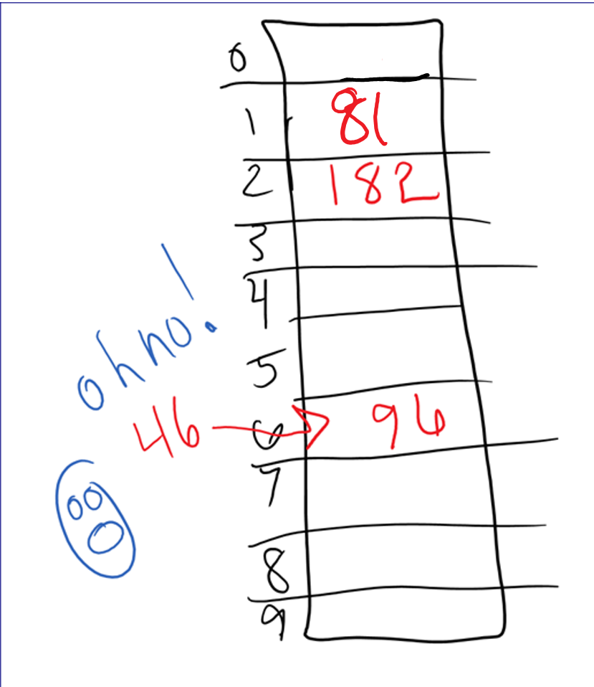
Hash Function with Modulus Operator (%)
KEY % N
Given a 10-element array, where would the following keys go?
key: 182%10 = 2
key: 96%10 = 6
key: 81%10 = 1
key: 46%10 = 6

Slide 12

Collision Handling

Slide 13
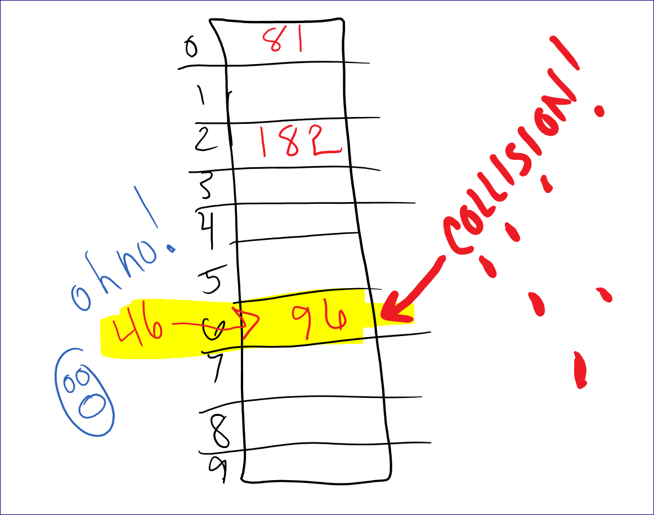
Collision
Collision occurs when an item being inserted in to a hash table maps to the same bucket as an existing item in the hash table.

Slide 14
Types of Collision Management
Open Hashing (Chaining)
Open hashing is when keys are stored in linked lists attached to cells of a hash table.
Closed Hashing (Linear Probing, Quadratic Probing, Double Hashing)
Closed hashing is when keys are all stored in the hash table itself without the use of linked lists.

Slide 15
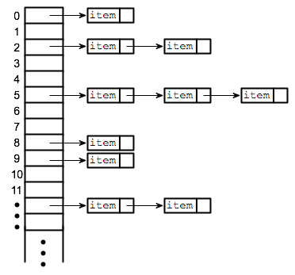
Chaining (open hashing)

Slide 16
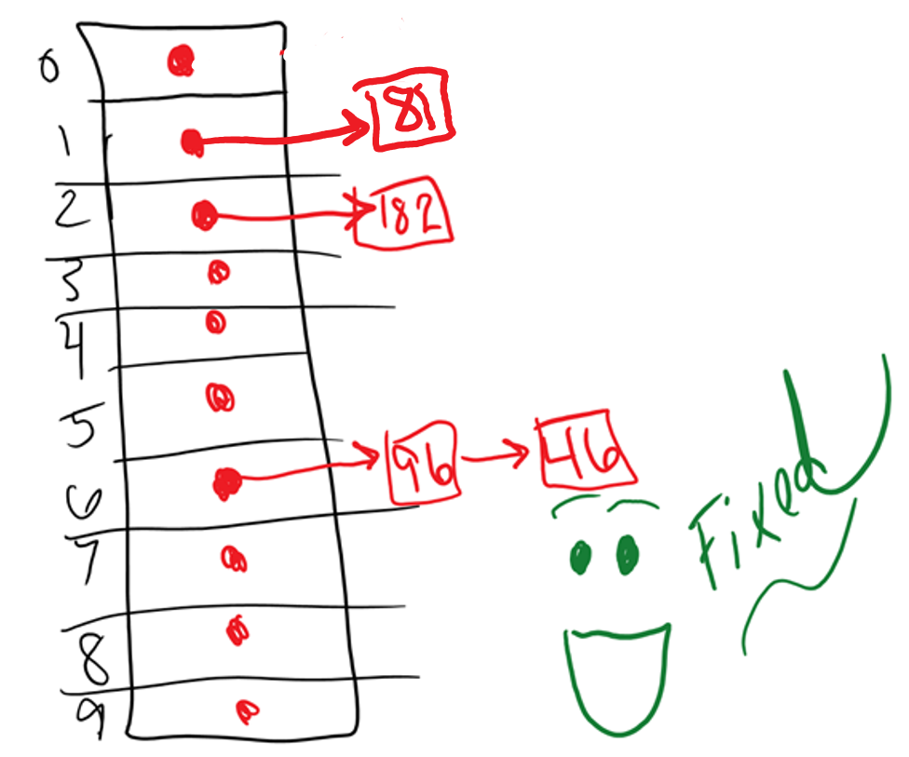
Chaining
Chaining is a way to prevent collision. It is a way that two values can go in the same bucket.
Chaining is where each bucket has a LIST of items

Slide 17
Chaining Options
The chain can be a linked list, stack, or queue.
Example with linked list in folder “Hash Table – Chaining”
Driver.cpp
HashEntry.h
HashTable.h

Slide 18
Linear Probing (closed hashing)

Slide 19
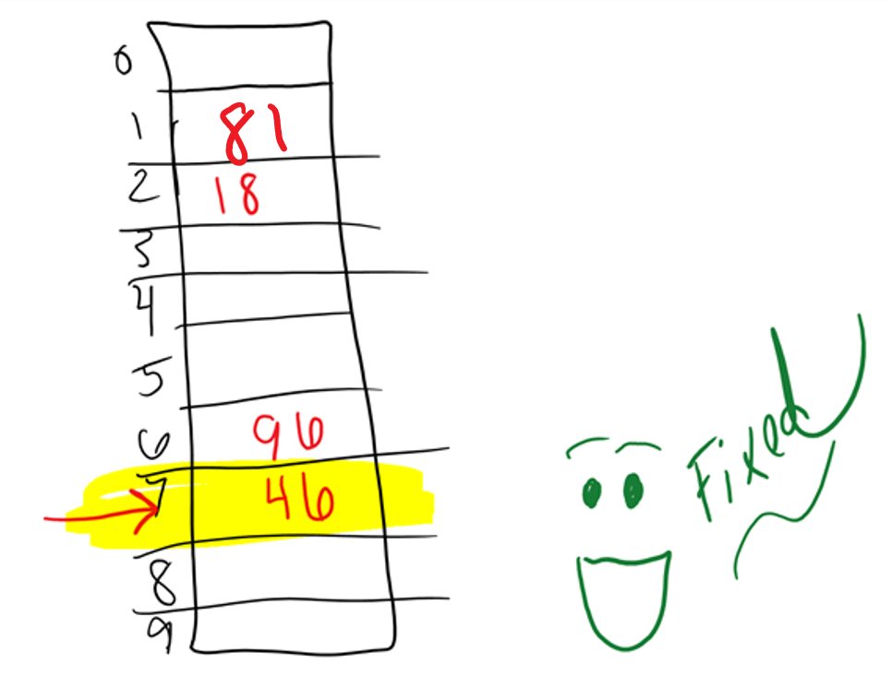
Linear Probing
Linear Probing handles a collision by starting at the key’s mapped bucket and then linearly searches subsequent buckets until an empty bucket is found.

Slide 20
Linear Probing Example
Example with linked list in folder “Hash Table – Linear Probing”
Driver.cpp
HashEntry.h
HashTable.h

Slide 21
Quadratic Probing (closed hashing)

Slide 22
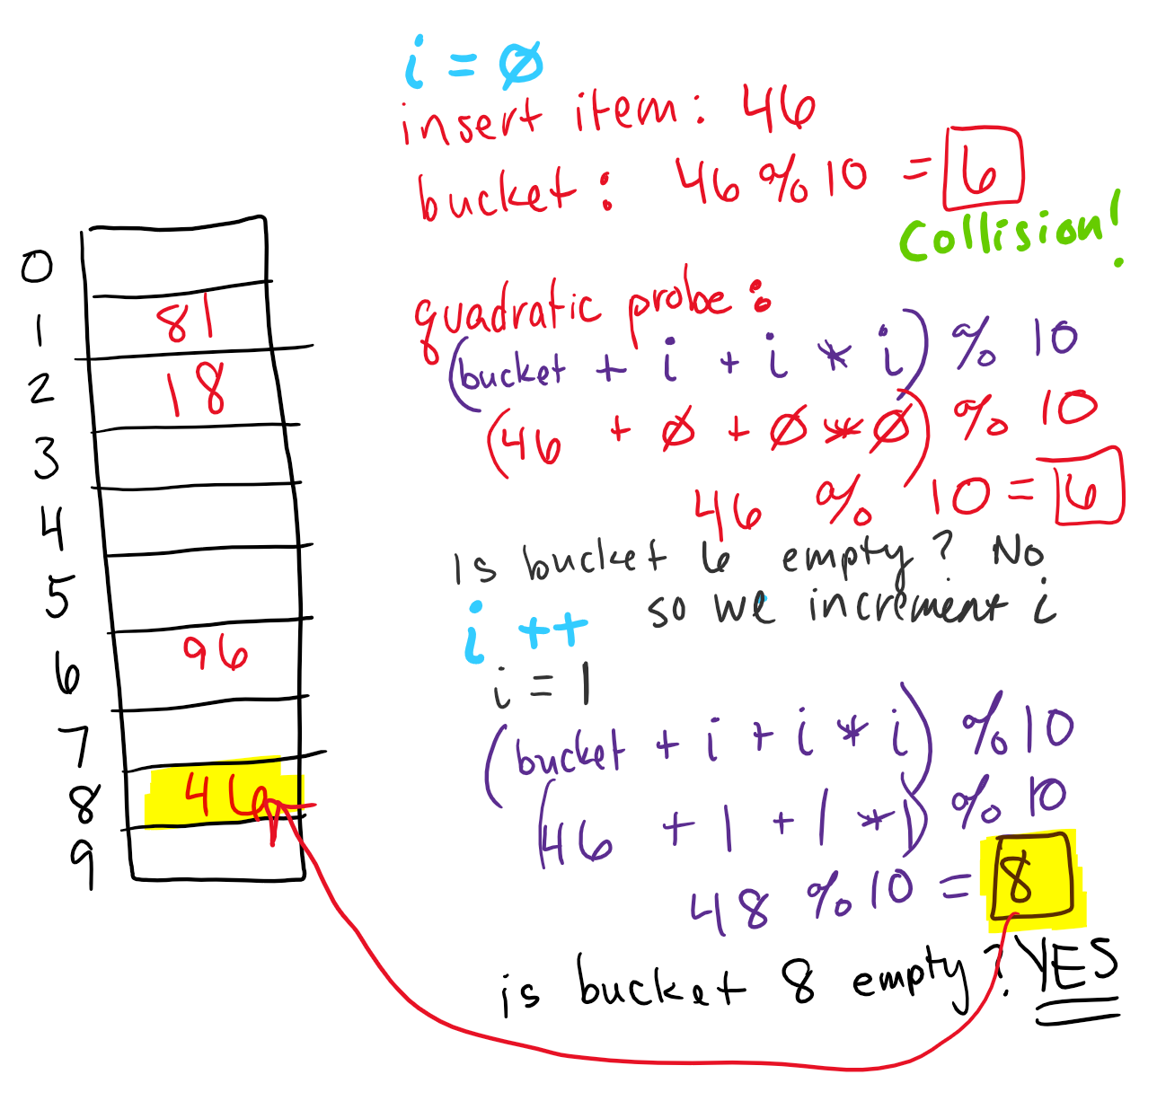
Quadratic Probing
Quadratic probing handles a collision by starting at the key’s mapped bucket, and then quadratically searches subsequent buckets until an empty bucket is found.

Slide 23
Double Hashing (closed hashing)

Slide 24
Double Hashing
Double hashing is a closed hashing collision resolution technique that uses 2 different hash functions to compute bucket indices.
H1 = key % (N-3) | H1 = 1st hash function N = hash table # elements
H2 = (N-2) – key % (N-2) | H2 = 2nd hash function N = hash table # elements
(H1 + i * H2 % N) | Double hashing probing sequence

Slide 25
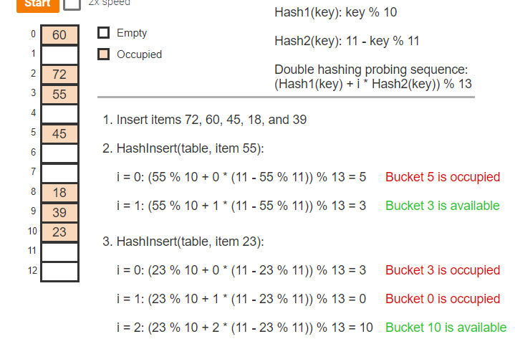
Double Hashing
H1 = key % (N-3) | H1 = 1st hash function N = hash table # elements
H2 = (N-2) – key % (N-2) | H2 = 2nd hash function N = hash table # elements
(H1 + i * H2 % N) | Double hashing probing sequence

Slide 26
Other Hash Functions

Slide 27
What is a PERFECT Hash Function?
A perfect hash function maps items to buckets with no collisions.

Slide 28
Other Hash Function Mid-Square Hash Function
A mid-square hash squares the key, extracts R digits from the result's middle, and returns the remainder of the middle digits divided by hash table size N.
STEP ONE: Square the key
Buckets (N) = 100 & example key = 467 Square of the key = 467² = 218,089

Slide 29
Other Hash Function Mid-Square Hash Function
STEP TWO: Extract R digits from the result’s middle
What is R? For N buckets, R must be greater than or equal to ⌈logN⌉ (in order to index all buckets)
Buckets (N) = 100 & example key = 467 Square of the key = 467² = 218,089
Log N = Log 100 = 2, so R must be >=2 (R = 2)
Middle 2 digits of 218,089 is 80.

Slide 30
Other Hash Function Mid-Square Hash Function
STEP THREE: Return the remainder of the middle digits divided by N.
Buckets (N) = 100 & example key = 467 Square of the key = 467² = 218,089
Log N = Log 100 = 1, so R must be >=2 (R = 2)
Middle 2 digits of 218,089 is 80.
80 % N = 80 % 100 = 80, so 80 is the bucket number

Slide 31
Other Hash Function Multiplicative String Hash Function
A multiplicative string hash repeatedly multiplies the hash value and adds the ASCII (or Unicode) value of each character in the string.
Value is a string like “ARC”
Get ASCII values of each letter: A=65, R=82, C=67
There is a random initial value (R) and a multiplier (M)
Calculation: (R*M+65)+(R*M+82)+(R*M+67)
Calculation: (if R=0 & M=1 then result is 214 % N) where N is the number of buckets.

Slide 32
Direct Hashing

Slide 33
Direct Hashing
A direct hash function uses the item's key as the bucket index. (If the key is 937, the index/bucket is 937)
A hash table with a direct hash function is called a direct access table.
Given a key, a direct access table search algorithm returns the item at index key if the bucket is not empty, and returns null (indicating item not found) if empty.

Slide 34


